Slide 1
Chapter 2: Operating-System Structures

Slide 2
Chapter 2: Operating-System Structures
Operating System Services
User Operating System Interface
System Calls
Types of System Calls
Operating System Design and Implementation
Operating System Structure
Virtual Machines

Slide 3
Operating System Services
Two sets of operating-system services:
The one set provides functions that are helpful to the user:
User interface - Means by which users can issue commands to the system.
Varies between Command-Line (CLI), Graphics User Interface (GUI), or Batch command system
Program execution - The system must be able to load a program into memory and to run that program, end execution, either normally or abnormally (indicating error)
I/O operations - A running program may require I/O, which may involve a file or an I/O device
File-system manipulation - The file system is of particular interest. Programs need to read and write files and directories, create and delete them, search them, list file Information, permission management.

Slide 4
Operating System Services (Cont.)
Communications – Processes may exchange information, on the same computer or between computers over a network
Communications may be via shared memory or through message passing (packets moved by the OS)
Error detection – OS needs to be constantly aware of possible errors
May occur in the CPU and memory hardware, in I/O devices, in user program
For each type of error, OS should take the appropriate action to ensure correct and consistent computing
Debugging facilities can greatly enhance the user’s and programmer’s abilities to efficiently use the system

Slide 5
Operating System Services (Cont.)
The second set of functions includes:
Resource allocation - When multiple users or multiple jobs running concurrently, resources must be allocated to each of them
Accounting - To keep track of which users use how much and what kinds of computer resources
Protection and security - The owners of information stored in a multiuser or networked computer system may want to control use of that information, concurrent processes should not interfere with each other
Protection involves ensuring that all access to system resources is controlled
Security of the system from outsiders and insiders requires user authentication, extends to defending external I/O devices from invalid access attempts
Notes:
Another set of OS functions exists for ensuring the efficient operation of the system itself via resource sharing. Many types of resources - Some (such as CPU cycles, main memory, and file storage) may have special allocation code, others (such as I/O devices) may have general request and release code

Slide 6
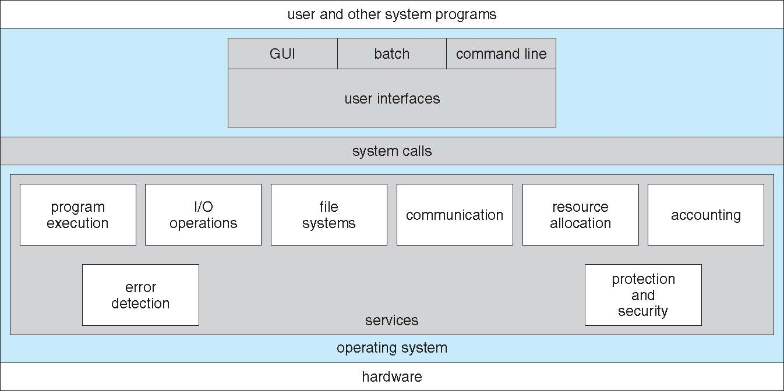
A View of Operating System Services

Slide 7
User Operating System Interface
Command Line Interface (CLI) or command interpreter allows direct command entry
Gets and processes the next user request, and launches the requested programs.
In some systems the CI may be incorporated directly into the kernel.
More commonly the CI is a separate program that launches once the user logs in or otherwise accesses the system.
UNIX, for example, provides the user with a choice of different shells, which may either be configured to launch automatically at login, or which may be changed on the fly.
Different shells provide different functionality

Slide 8
User Operating System Interface
Graphical User Interface, GUI
Generally implemented as a desktop metaphor, with file folders, trash cans, and resource icons.
First developed in the early 1970's at Xerox PARC research facility.
Mac has traditionally provided ONLY the GUI interface. With the advent of OSX ( based partially on UNIX ), a command line interface has also become available.
Because mice and keyboards are impractical for small mobile devices, these normally use a touch-screen interface today, that responds to various patterns of swipes.

Slide 9
System Calls
System calls provide a means for user or application programs to call upon the services of the operating system.
Typically written in a high-level language (C or C++)
Mostly accessed by programs via a high-level Application Program Interface (API) rather than direct system call use
Three most common APIs are Win32 API for Windows, POSIX API for POSIX-based systems (including virtually all versions of UNIX, Linux, and Mac OS X), and Java API for the Java virtual machine (JVM)

Slide 10
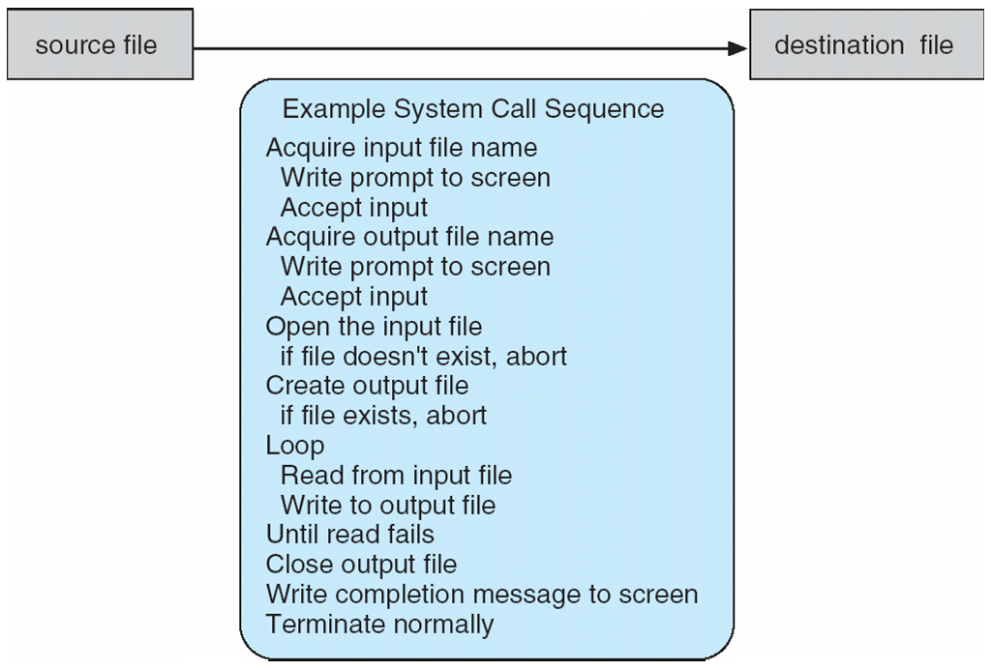
Example of System Calls
System call sequence to copy the contents of one file to another file

Slide 11
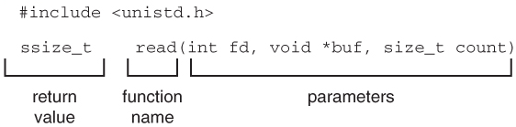
Example of Standard API
Consider the read() function that is available in Unix and Linux systems. The API for this function is obtained from the man page by invoking the command
man read
on the command line. A description of this API is:
The parameters are:
int fd – The descriptor to be read
void *buf – A buffer where the data will be read into
size_t count – the maximum number of bytes to be read into the buffer

Slide 12
System Call Implementation
The caller need know nothing about how the system call is implemented
Just needs to obey API and understand what OS will do as a result call
Most details of OS interface hidden from programmer by API
Managed by run-time support library (set of functions built into libraries included with compiler)
The use of APIs instead of direct system calls provides for greater program portability between different systems.
The API makes the appropriate system calls through the system call interface, using a table lookup to access specific numbered system calls

Slide 13
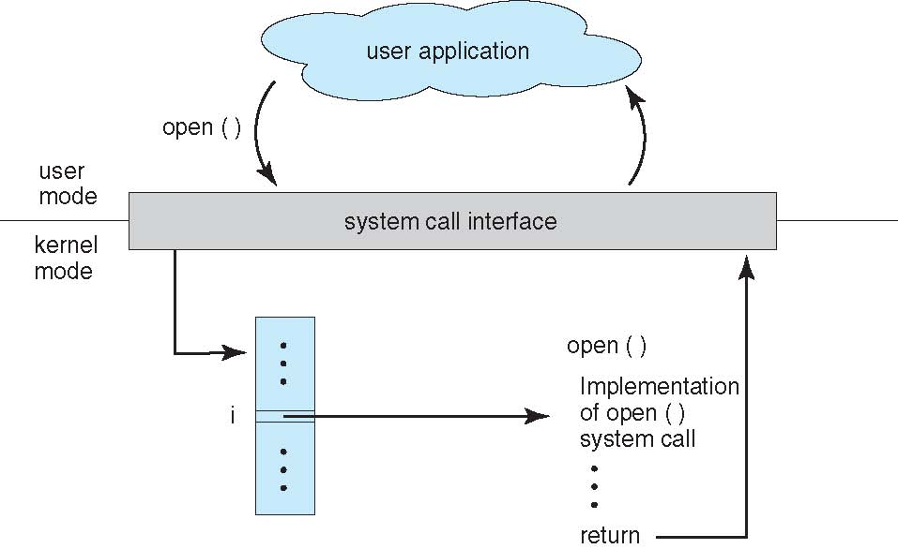
API – System Call – OS Relationship

Slide 14
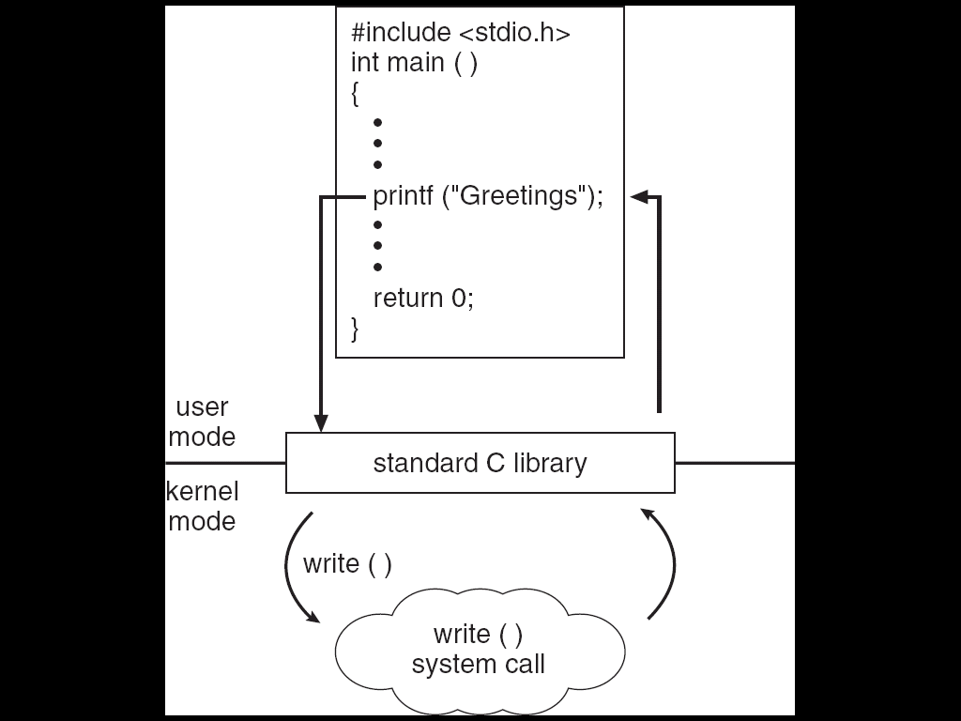
Standard C Library Example
C program invoking printf() library call, which calls write() system call

Slide 15
System Call Parameter Passing
Three general methods used to pass parameters to the OS
Simplest: pass the parameters in registers
In some cases, may be more parameters than registers
Parameters stored in a block, or table, in memory, and address of block passed as a parameter in a register
This approach taken by Linux and Solaris
Parameters placed, or pushed, onto the stack by the program and popped off the stack by the operating system
Block and stack methods do not limit the number or length of parameters being passed

Slide 16
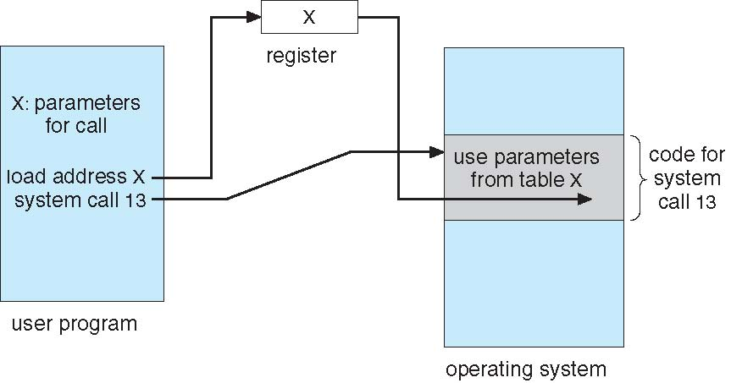
Parameter Passing via Table

Slide 17
Types of System Calls
Process control
end, abort
load, execute
create process, terminate process
get process attributes, set process attributes
wait for time
wait event, signal event
allocate and free memory
File management
create file, delete file
open, close file
read, write, reposition
get and set file attributes

Slide 18
Types of System Calls (Cont.)
Device management
request device, release device
read, write, reposition
get device attributes, set device attributes
logically attach or detach devices
Information maintenance
get time or date, set time or date
get system data, set system data
get and set process, file, or device attributes
Communications
create, delete communication connection
send, receive messages
transfer status information
attach and detach remote devices

Slide 19
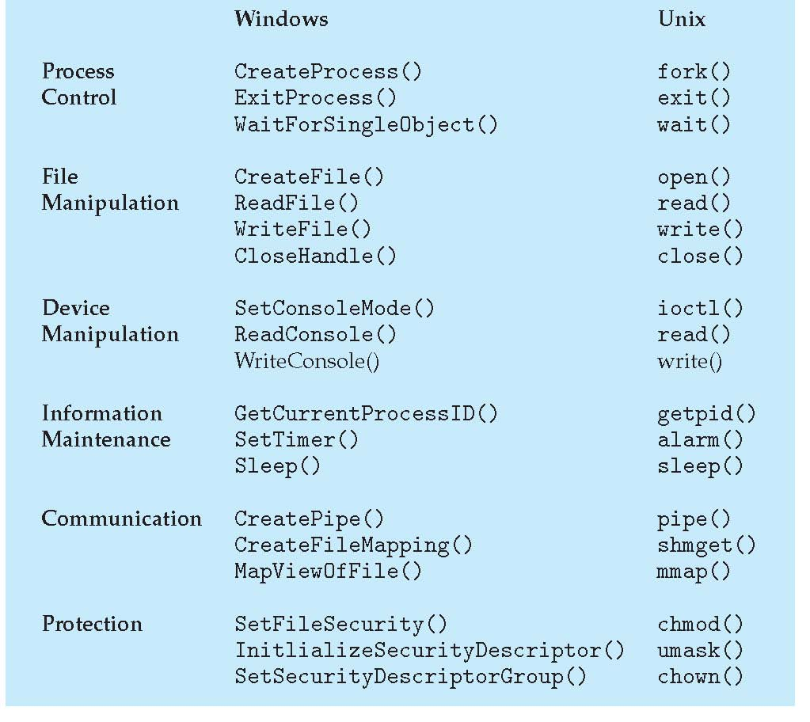
Examples of Windows and Unix System Calls

Slide 20
MS-DOS
Single-tasking systems
Shell invoked when system booted
Simple method to run program
No process created
Single memory space
Loads program into memory, overwriting all but the kernel
Program exit -> shell reloaded

Slide 21
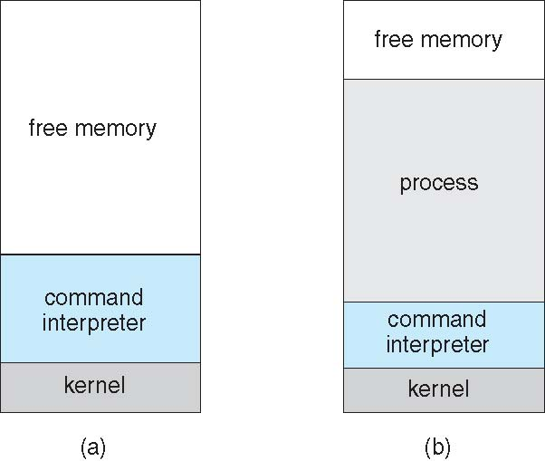
MS-DOS execution
(a) At system startup (b) running a program

Slide 22
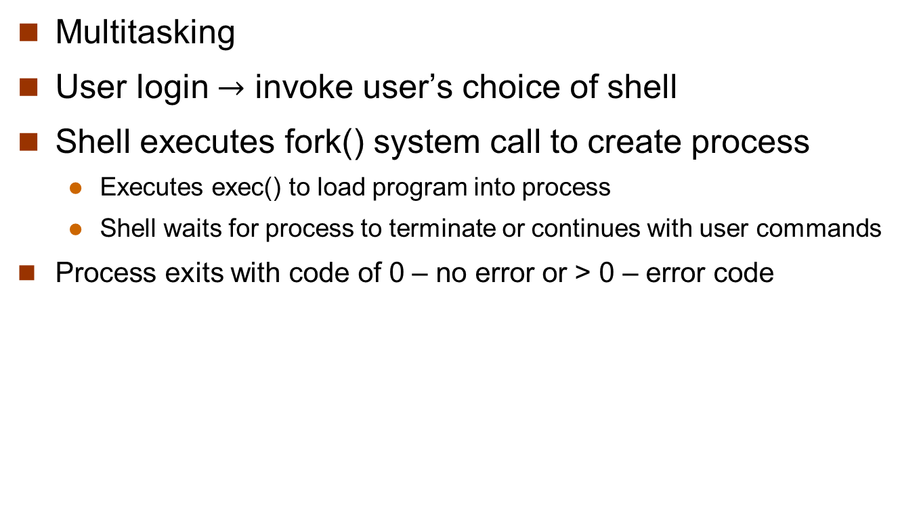
Unix
Multitasking
User login $→$ invoke user’s choice of shell
Shell executes fork() system call to create process
Executes exec() to load program into process
Shell waits for process to terminate or continues with user commands
Process exits with code of 0 – no error or > 0 – error code

Slide 23
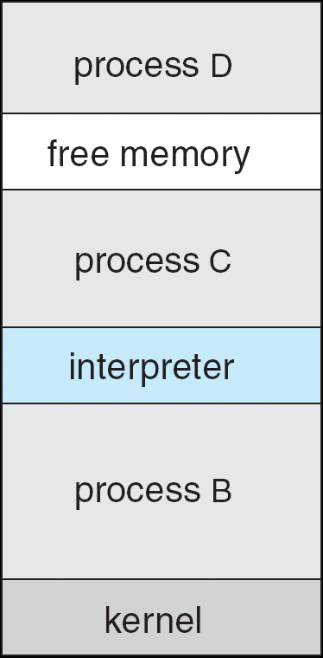
FreeBSD Running Multiple Programs

Slide 24
System Programs
System programs provide a convenient environment for program development and execution. They can be divided into:
File manipulation (Create, delete, copy, rename, print, dump, list, etc.)
Status information (date, time, amount of available memory, disk space, number of users)
File modification (Text editors to create and modify files)
Programming language support (Compilers, assemblers, debuggers and interpreters are provided)
Program loading and execution (Absolute loaders, relocatable loaders, linkage editors, debugging, etc.)
Communications
Application programs
Most users’ view of the operation system is defined by system programs, not the actual system calls

Slide 25
Operating System Design and Implementation
Design and Implementation of OS not “solvable”, but some approaches have proven successful
Internal structure of different Operating Systems can vary widely
Start by defining goals and specifications
Affected by choice of hardware, type of system
User goals and System goals
User goals – operating system should be convenient to use, easy to learn, reliable, safe, and fast
System goals – operating system should be easy to design, implement, and maintain, as well as flexible, reliable, error-free, and efficient

Slide 26
Operating System Design and Implementation (Cont.)
Important principle to separate
Policy: What will be done? Mechanism: How to do it?
Mechanisms determine how to do something, policies decide what will be done
The separation of policy from mechanism is a very important principle, it allows maximum flexibility if policy decisions are to be changed later

Slide 27
Implementation
Traditionally OSes were written in assembly language. This provided direct control over hardware-related issues, but tied a particular OS to a particular HW platform.
Recent advances in compiler efficiencies mean that most modern OSes are written in C, or more recently, C++. Critical sections of code are still written in assembly language, ( or written in C, compiled to assembly, and then fine-tuned and optimized by hand from there. )

Slide 28
Simple Structure
MS-DOS – written to provide the most functionality in the least space
Not divided into modules
Although MS-DOS has some structure, its interfaces and levels of functionality are not well separated

Slide 29
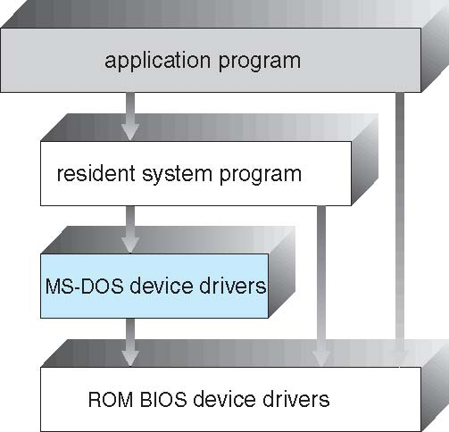
MS-DOS Layer Structure

Slide 30
Layered Approach
The operating system is divided into a number of layers (levels), each built on top of lower layers. The bottom layer (layer 0), is the hardware; the highest (layer N) is the user interface.
With modularity, layers are selected such that each uses functions (operations) and services of only high-level layers

Slide 31
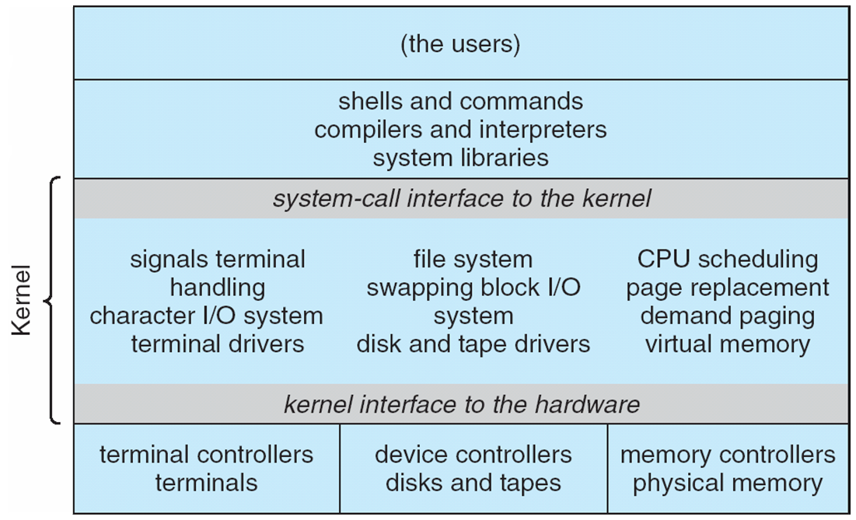
Traditional UNIX System Structure
Notes:
UNIX – limited by hardware functionality, the original UNIX operating system had limited structuring. The UNIX OS consists of two separable parts
Systems programs
The kernel

Slide 32
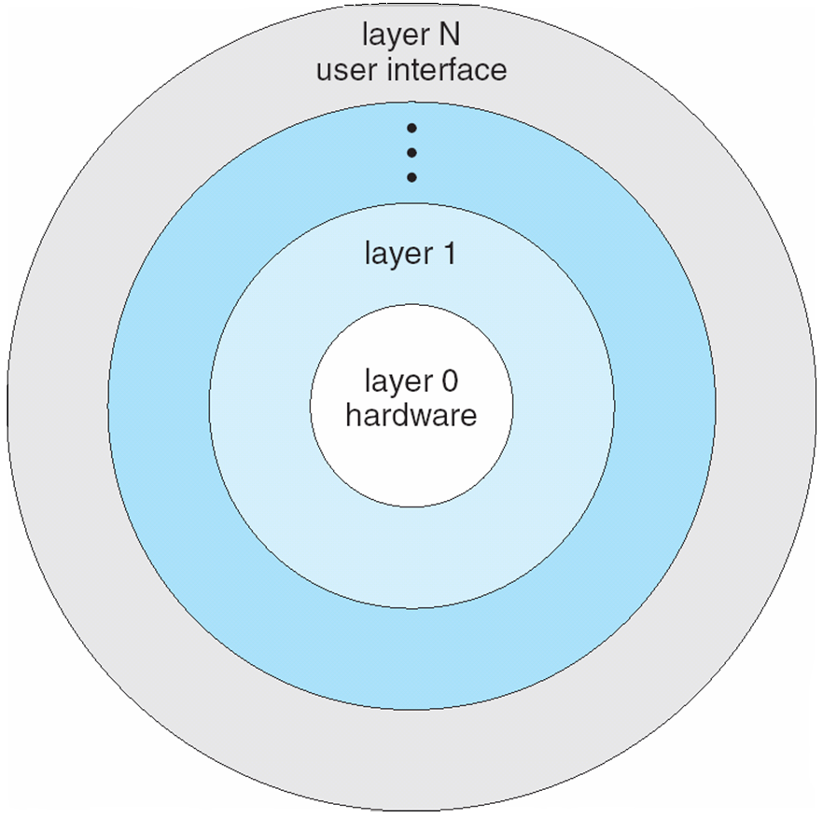
Layered Operating System

Slide 33
Microkernel System Structure
Moves as much from the kernel into “user” space
Communication takes place between user modules using message passing
Benefits:
Easier to extend a microkernel
Easier to port the operating system to new architectures
More reliable (less code is running in kernel mode)
More secure
Detriments:
Performance overhead of user space to kernel space communication

Slide 34
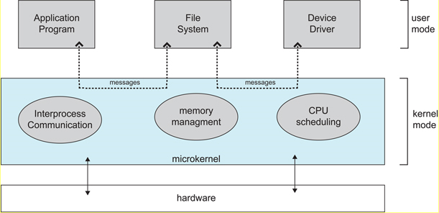
Architecture of a typical microkernel

Slide 35
Modules
Most modern operating systems implement kernel modules
Uses object-oriented approach
Each core component is separate
Each talks to the others over known interfaces
Each is loadable as needed within the kernel
Overall, similar to layers but with more flexibility

Slide 36
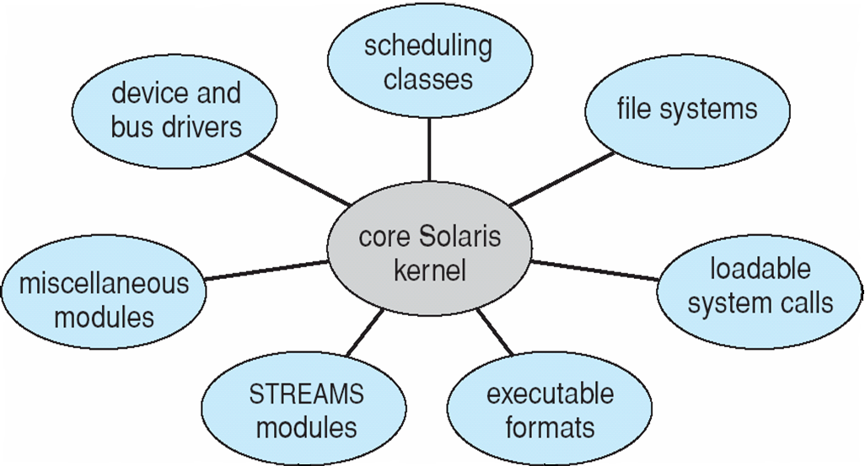
Solaris Modular Approach

Slide 37
Virtual Machines
A virtual machine takes the layered approach to its logical conclusion. It treats hardware and the operating system kernel as though they were all hardware.
A virtual machine provides an interface identical to the underlying bare hardware.
The operating system host creates the illusion that a process has its own processor and (virtual memory).
Each guest provided with a (virtual) copy of underlying computer.

Slide 38
Virtual Machines History and Benefits
First appeared commercially in IBM mainframes in 1972
Fundamentally, multiple execution environments (different operating systems) can share the same hardware
Protect from each other
Some sharing of file can be permitted, controlled
Commutate with each other, other physical systems via networking
Useful for development, testing
Consolidation taking two or more separate systems and running them in virtual machines on one system
“Open Virtual Machine Format”, standard format of virtual machines, allows a VM to run within many different virtual machine (host) platforms

Slide 39
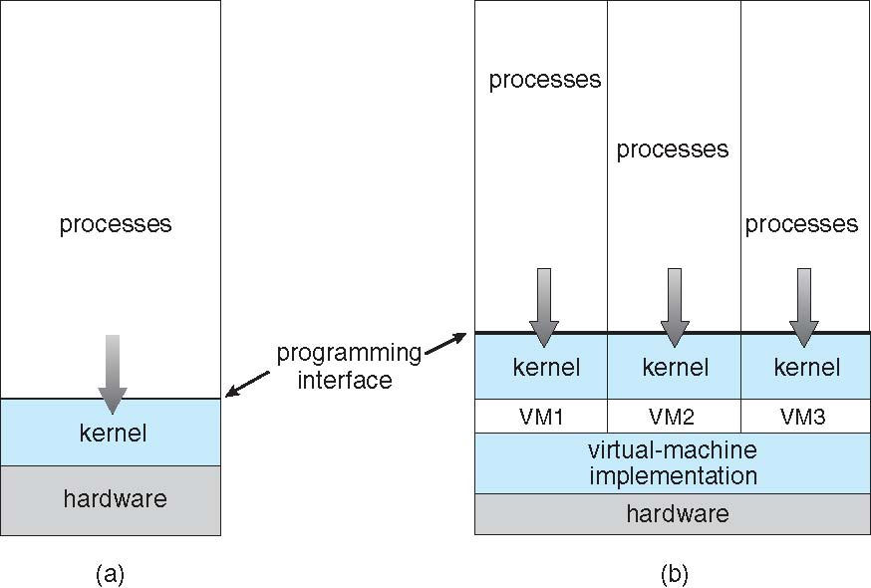
Virtual Machines (Cont.)
(a) Nonvirtual machine (b) virtual machine

Slide 40
Virtualization Implementation
Difficult to implement – must provide an exact duplicate of underlying machine
Typically runs in user mode, creates virtual user mode and virtual kernel mode
Timing can be an issue – slower than real machine
Hardware support needed
More support-> better virtualization

Slide 41
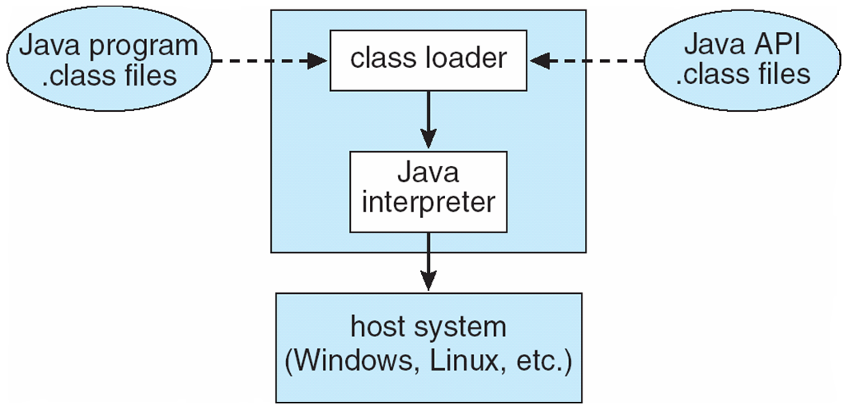
The Java Virtual Machine

Slide 42
Operating-System Debugging
Debugging is finding and fixing errors, or bugs
OSs generate log files containing error information
Failure of an application can generate core dump file capturing memory of the process
Operating system failure can generate crash dump file containing kernel memory
Beyond crashes, performance tuning can optimize system performance
Kernighan’s Law: “Debugging is twice as hard as writing the code in the first place. Therefore, if you write the code as cleverly as possible, you are, by definition, not smart enough to debug it.”

Slide 43
Questions
Q1. What are the user and system goals in operating system design?
Q4. What are two main categories of the services and functions provided by an operating system? Briefly describe the two categories.
Q5. What are five major activities of an operating system with regard to process management?
Q6. What are six major categories of system calls?
Q7. What are three different forms of a user interface that almost all an operating system have?
Q8. What is the fundamental idea behind a virtual machine?

Slide 44
End of Chapter 2

